Slide 1
Nuclear Forces

Slide 2

In this Smart Lesson you will learn to:
Define the strong nuclear force.
Explain the stability of a nuclide in terms of forces and numbers of protons and neutrons.

Slide 3


Slide 4

The four fundamental forces are:
1. Gravitational forces.
2. Electromagnetic forces.
3. Strong nuclear forces.
4. Weak nuclear forces.

Slide 5
So how does the nucleus of the atom stay together?
Like charges repel due to their electromagnetic force, so there must be another force which overcomes this to hold the nucleus together.
A gravitational force is the attractive force between two masses. However, gravity is far too weak to overcome the electromagnetic force.

Slide 6
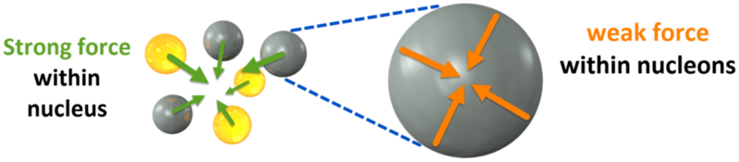
The strong nuclear force is a force which acts between nucleons.
It is stronger than the electromagnetic force, so it holds the nucleus together.
There is a fourth force, called the weak nuclear force. This acts within nucleons.
The weak nuclear forces between subatomic particles lead to radioactive decay and play an important role in nuclear fission.
Definition: a nucleon is the particles (protons and neutrons) that make up the nucleus of an atom.

Slide 7
So how are strong nuclear forces defined?
A strong nuclear force is one of the four fundamental forces; the strong nuclear force acts over small distances in the nucleus to hold the nucleons together against the repulsive electrostatic forces exerted between the protons; the strong nuclear force is mediated by gluons.

Slide 8

Which force is strongest?
Gravitational forces are the weakest force. You might expect the weak nuclear force to be weaker, but it is actually 10³² times stronger than gravity!
The electromagnetic force is stronger than the weak nuclear force. However, we know that the strong nuclear force must be the strongest since it can overcome electromagnetic forces.

Slide 9
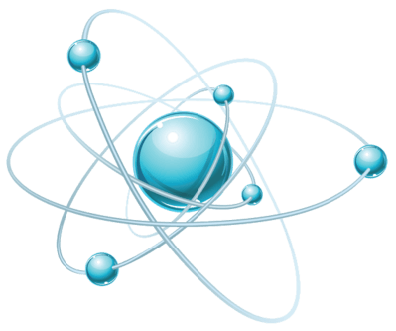
Stability of the nucleus.
Now that we know the forces acting on the nucleus, we can understand how these forces interact to make a nucleus stable or unstable.
The key idea that you need to remember for this section is that the strong nuclear force overcomes the electromagnetic repulsive force.

Slide 10
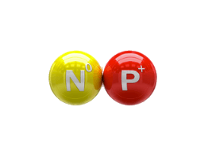
Neutrons buffer the protons, reducing the electrostatic force between them.
This increases the stability of the nucleus.
The nucleus is stable when there are enough neutrons to act as charge buffers towards the positive protons. Most stable nuclei are roughly half neutrons and half protons.
However, heavy nuclei have lots of protons, so they have a very large electromagnetic force. This means that heavy nuclei need more neutrons than protons to be stable.

Slide 11
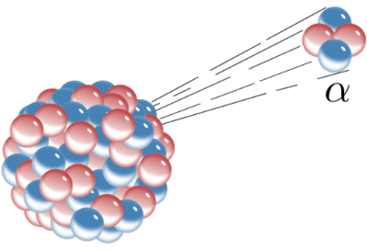
Unstable nuclei.
An unstable nucleus always tries to become more stable. It does this by emitting alpha, beta or gamma radiation.
Emitting this radiation causes the composition of the nucleus to change, making it more stable.
Alpha particles have two protons and two neutrons, beta particles are electrons or positrons and gamma radiation is energy.

